Slide 1
Project presentation
Introduction to Software Engineering
Group 103 - SpUStify

Slide 2




Table of Contents
Introduction
Project Management
Software Requirements
Analysis & Design
Software Testing
Demo
Problem Statement
Product Position Statement
Users/Market
Team Structure
Responsibilities
Use-Case Model
Non-Functional Requirements
Architecture
Technologies Used
Test Environments
Test Plan
Test Results
Key Scenario Demonstration

Slide 3
Problem Statement
We are passionate about music and love listening to songs
SpUStify
The Problem: Difficulty in accessing free songs online
Who it Affects: Music listeners
Impact: Listeners either pay for music or face disruptive ads
Notes:
Our project comes from our love of music and our team's interest in listening to songs. The problem we're addressing is the difficulty people face when listening to music online for free, accessing their favorite songs, making playlists, and personalizing their music experience. This problem mainly affects music listeners. The result is that listeners either have to pay to enjoy music or have their music interrupted by annoying ads. A successful solution would be to create a free music platform that allows people to listen to music without cost or ads.

Slide 4





Product Position Statement
For: Music listeners and artists
SpUStify
Unlike: Zing Mp3, Spotify
Who: Publish, listen, create playlists
What: A music platform without ads
Empowers music artists and offers an ad-free listening experience
Notes:
Meet SpUStify, our music platform here to help music fans and artists.It's a platform where artists can easily share their music, and music lovers can listen to songs without ads and create their own playlists. Unlike other platforms like Zingmp3 and Spotify, SpUStify is all about making music accessible without interruptions

Slide 5



User and Market
Initially
Expansion
Long-term Vision
21CLC06 class students
VNUHCM - University Of Science
All music lovers
Notes:
SpUStify initially targets students in the 21CLC06 class and plans to expand to include all students at the University of Natural Sciences in Ho Chi Minh City. But our bigger goal is to welcome anyone who loves music and wants to share and discover new songs. SpUStify aims to build a community where music brings people together, and everyone can enjoy music.

Slide 6
Team Roles & Responsibilities
Project Manager
Dương Trường Bình
Architecture team
BA Team
Developer Team
Tester Team
Designer Team
Nguyễn Tuấn Thanh
Dương Trường Bình
Nguyễn Thị Phương Trinh
Trần Đức Hoàng
Nguyễn Tuấn Thanh
Dương Trường Bình
Nguyễn Thị Phương Trinh
Nguyễn Tuấn Thanh
Phạm Văn Minh
Trần Đức Hoàng
Phạm Văn Minh
Dương Trường Bình
Nguyễn Thị Phương Trinh
Nguyễn Tuấn Thanh
Trần Đức Hoàng
Nguyễn Thị Phương Trinh
Phạm Văn Minh
Trần Đức Hoàng

Slide 7




Dương Trường Bình
Team, Time management
Reporting and Document
Project planning
Quality Assurance
Developing and Testing
Project scopes, Objectives, Deliverables
Project quality
Back-end, Testing key functions

Slide 8

Nguyễn Tuấn Thanh
Developing
Testing
Implement Back-end
Testing key functions
Architectural Development
Quality Assurance
Back-end Quality
Project scopes, Objectives, Deliverables

Slide 9

Phạm Văn Minh
Developing
Designing
Implement Front-end
Design UI
Test management
Quality Assurance
Front-end Quality
Lead testing efforts, roles

Slide 10
Nguyễn Thị Phương Trinh
Developing
Testing
Implement Front-end
Testing key functions
Architectural Development
Designer Leader
Architectural Aspects
Assign Task to Design Team, Design UI

Slide 11
Trần Đức Hoàng
Developing
Testing
Implement Front-end
Testing key functions
Designing
Reports and Documents
Design UI
Plans, Schedules, Reports

Slide 12
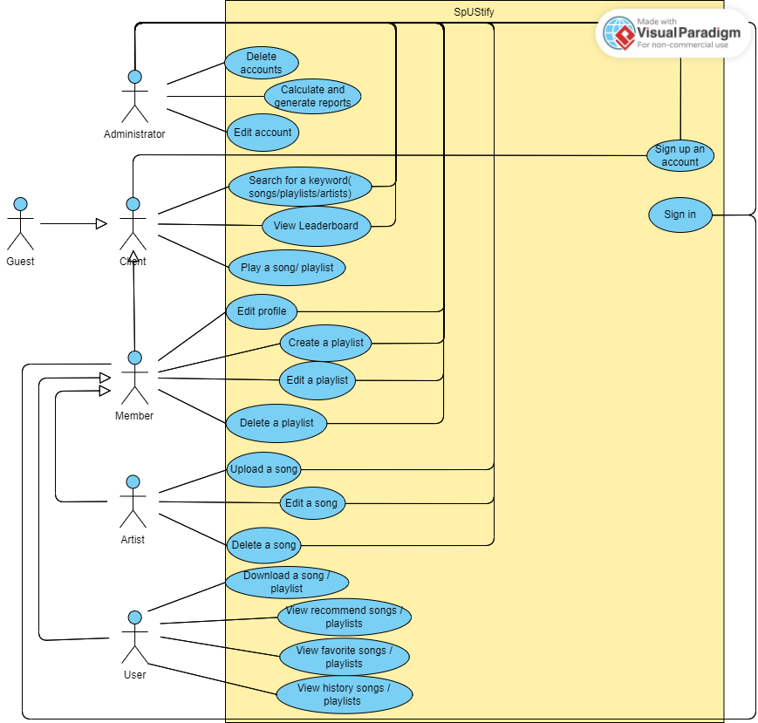
Use Case Model

Slide 13





Non-functional requirements
Integrity
Migration
Usability
Speed and Performance
User Interface

Slide 14
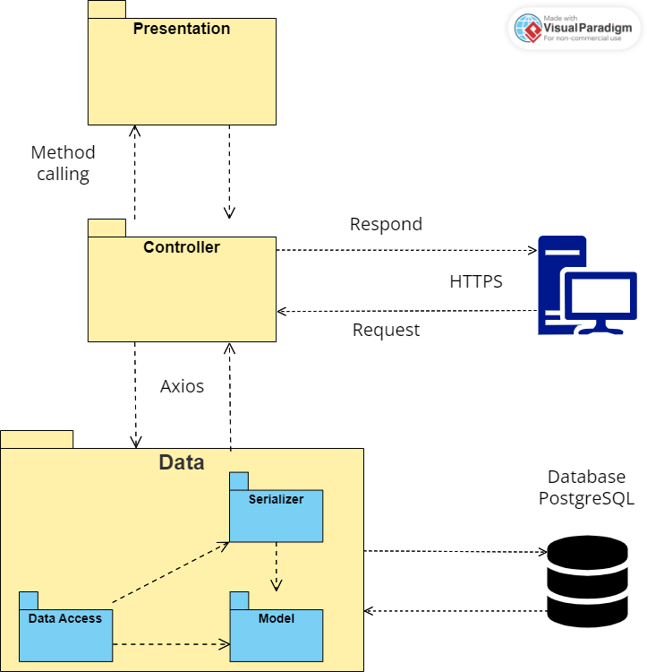
Logical View

Slide 15
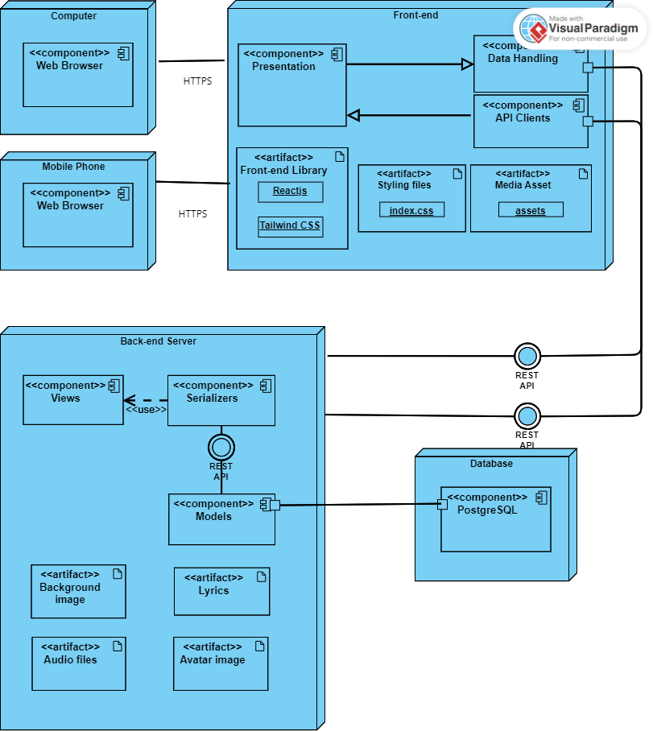
Deployment diagram

Slide 16
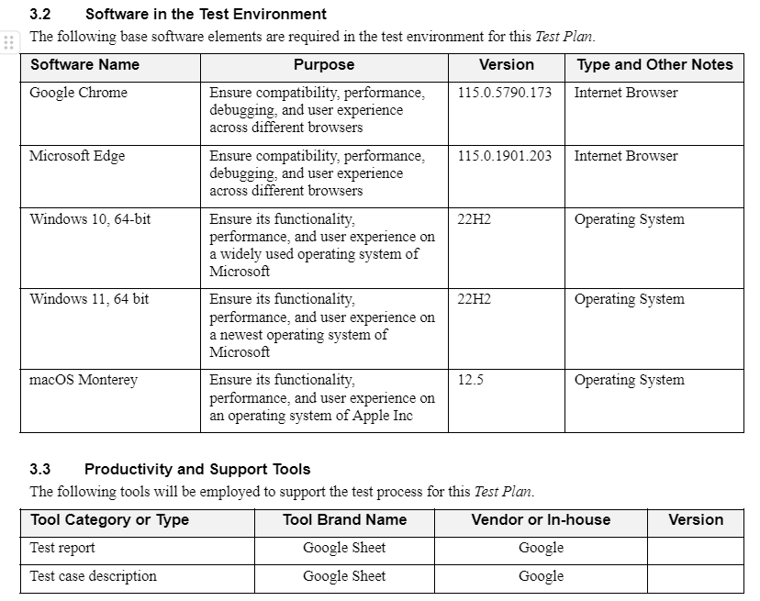
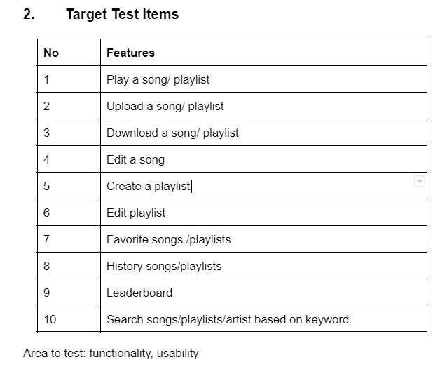
Test plan

Slide 17
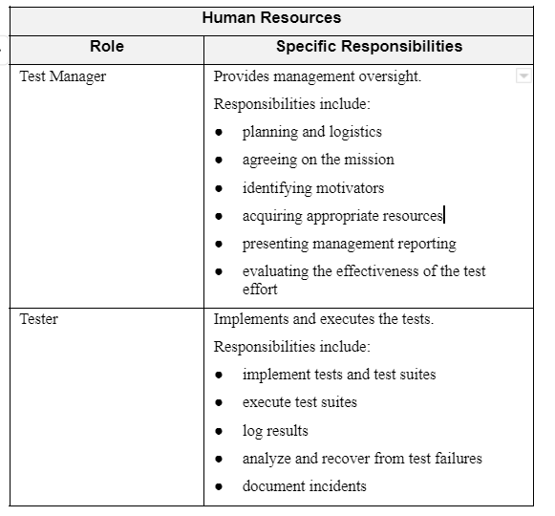
People and Roles

Slide 18
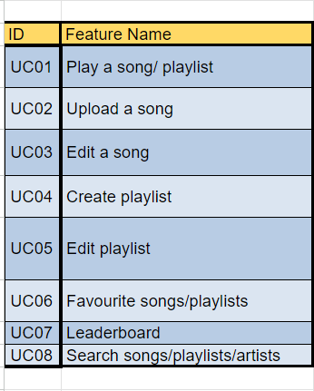
Test cases and results
Number of test cases | Number of passed test cases | Number of failed test cases | Number of defects fixed
44 | 37 | 7 | 3/7

Slide 19
Links of demo videos for each feature
Play song: https://youtu.be/dvaEGy99No4
Upload song: https://youtu.be/M3tyCeEiQzc
Edit song: https://youtu.be/xL24IU62dyA
Create playlist: https://youtu.be/fhLBD0nx90Q
Edit playlist: https://youtu.be/lBnaR9Bq-p0
Leaderboard and Favorite songs: https://youtu.be/I3geku1i85A
Search: https://youtu.be/imS_GTE2--Q

Slide 20
Thank you
for your listening

